Slide 1
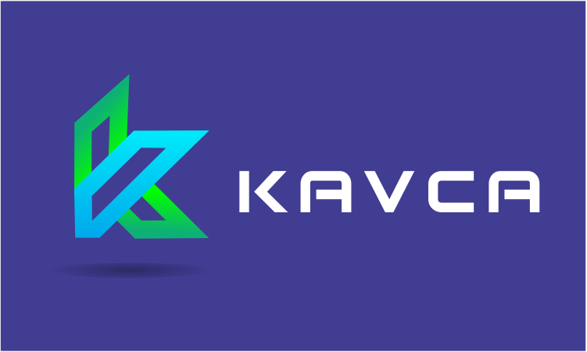
KAVCA AKM History and Background
The evolution of Active Knowledge Modelling and exploitation of Practical Knowledge and Digital AKMs.

Slide 2
Contents
The history of AKM Modeling
The AKM Technology Foundations
The AKM Pilot and R&D projects
The KAVCA Business Idea

Slide 3
The history of AKM Modelling
Metis original version(1988 - 2004)
Unix version single user at Volvo Cars (1989 - 1994)
Windows version single user (1993 - 2004)
Collaboration using sub-models (1998)
Troux Architect at Troux Technologies (2005 - 2008)
Synchronized with Troux Repository (2006)
AKM on Metis at Commitment AS (2007 – 2018 )
R&D and Pilot-projects: Athena, MAPPER and Cospaces (2007 – 2014)
Novel AKM on the Web with KAVCA AS (2018 - )
NTNU Student-project MetisApp prototype (2017)
MetisApp version 0.1 (Javascript) (2018 - )
Notes:
The first METIS tool and concepts were created in an innovation project at Volvo Cars from 1988 to 1991. The most important concepts were discovering and modelling dependent aspects of product structures, processes, organizations and modelling and execution platforms.
In 2003, following projects at Volvo Cars, Boeing CA and many European and US use-case demonstrators, we discovered the need for more fine-grained symbolic languages, the IRTV language, and how to model and exploit the practical and tacit knowledge of humans. This was implemented on the METIS tools in 2005. The solutions were offered to Troux Technologies, but they were not ready to take this step. T
There were many hurdles we had to overwin ranging from tool installation with new users, safe and adequate knowledge capture and sharing, user modelling team involvement, and competition for systems engineers.

Slide 4


The Active Knowledge Modeling foundations
Closing and activating Pragmatic Learning Processes
Creating value through knowledge sharing and collaboration
Digital networks used as multi-media enabled by software.
generates
new data
interpretation
Data
Methods
Information
innovation
associations to other
views and structures
Active Knowledge - Scenes of Action - Roles
Experience
Knowledge
performing work
in varying settings
associations to
actions and tasks
Skill
Competence
performing work
Ref.: Lave & Wenger
Notes:
The figure illustrates the Pragmatic Learning Process (PLP) from Data to Information, through views and templates, to Knowledge through associations to more views and structures, to Competence through associations to actions and tasks, to Skill by performing work, to Experience by varying work environments, to Methods evolution through gradual improvement and open innovation, which generates new Data.
The understanding and importance of Pragmatic Learning has emerged since 2001, and has been a core concept for the AKM technology development and discoveries. Active Knowledge is created in Enterprise Knowledge Spaces, and used to plan, execute, govern and support work. Pedagogues use the terms Situated or Work-sensitive Knowledge, and recognize that knowledge exists in our brain as mental models, consisting of multi-dimensional reflective aspects. The properties of mental models, Reflective views, Repetitive task-patterns, Replicable templates and Reusable knowledge spaces, are very similar to the properties of the multi-dimensional Workspaces and Enterprise Knowledge Spaces discovered by the agile approach to Enterprise Modelling, as discovered by AKM.

Slide 5
METIS and AKM pilots - and R&D projects
1990 – METIS and AKM pilotproject at Volvo Cars
1993 – McDD, MCI, Boeing , FORD, NASA and NCR AT&T
2006 – Studies and testmodels with Statoil Teknology
Project Specific Technology Strategy
2007 – Studies and testmodels ved Selvaag Bygg
Conceptual product design and Configurable Components
2008 – Kongsberg Automotive
Configurable project platforms – Seat Heat design
2009 – Aker Solutions Project design
Project Execution Methodology forbedringer
2009 – EU R&D projects – Athena (2007 – 09), MAPPER (2009- 11), CoSpaces (2011- 2013)

Slide 6
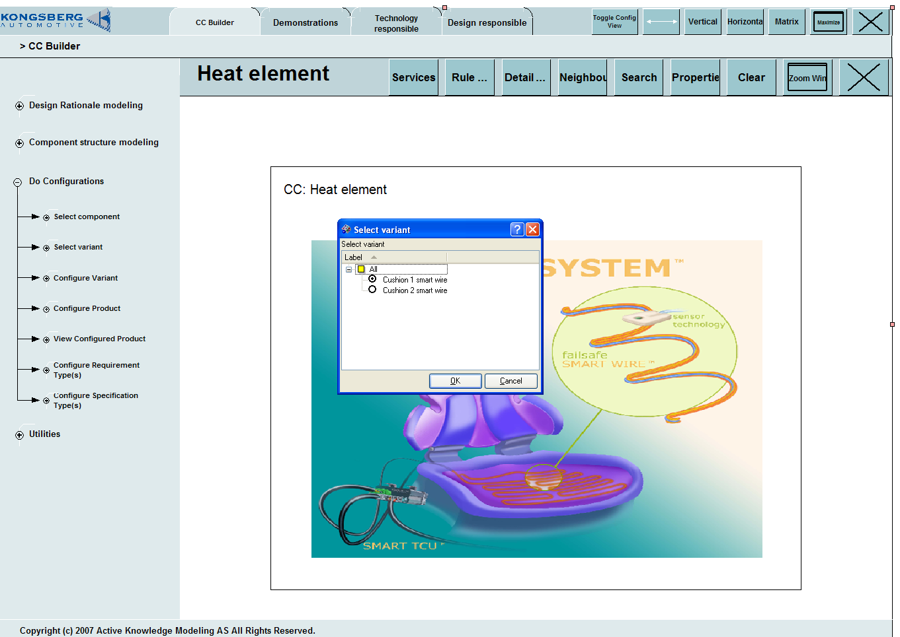
Selecting a Product Variant
Select configuration variant and configure components
... or select by setting variant parameter values

Slide 7




Technical Architecture – METIS and AKM in Use
Visual
Workspaces
On the Web
Customer
Application
Front-Ends
Web Interface
Metis Client Tools
View Management Services
EKA Interface
Customer
Web Content
and Services
Portal /
Dashboard
Metis Team
Server
Model Designed
Portal
Event
Coordination
Interface
Policy
Management
Customer
Execution
Systems
Metis Enterprise
Repository
Reporting
System
Workflow
Engine
Metis Repositories
Execution
Services
Customer
Data Sources
Metis Collection
Metis Enterprise Server
Notes:
Core Platform:
The main emphasis on this slide is that we still have product within the platform that can be sold stand alone for Custom solutions.
We will work on a case by case basis to grandfather existing install base to the common platform.
We will continue to invest in making the platform “well formed” and tightly integrated so that we this core technology base can more easily support the applications development, partners, customers and services organizations as they extend from it.

Slide 8
AKM modelling for Quality Data and Knowledge Management
Sustainable Well Design, Operations and Production
Knowledge products for effective data management
Field Analysis
OSDU services
Wellbore outcomes
Field Assets
Well Design
CVCV
Project
Workspaces
Field
Services
CVCV
WellboreMarkers
Strategi-graphics
Trajectory
models
CVCV
Well Logs
Workspaces Views
Drilling
Workspaces
Project Values
Project
Design
CVCV
CV
Well
Models
Knowledge Architectures
Operations Planning
AKM Data services
Equinor O&G projects
OSDU Management

Slide 9
KAVCA Business Idea
Values : Allowing industry and societies to exploit the potential of the digitalization web, supporting cyclic design, collaboration and knowledge sharing, and operations.
Market: All international industries and most public sectors will benefit.
Uniqueness: Exploiting Visual Modelling of both explicit and hidden knowledge to support evolutionary systems, visual collaboration arenas, and user-composed workplaces supporting collaboration, and innovation and learning, and cyclic design and execution.
Status: - The first operational web-based platform, workplaces and use-cases will be delivered to EQUINOR ASA in March 2022.

